Slide 1

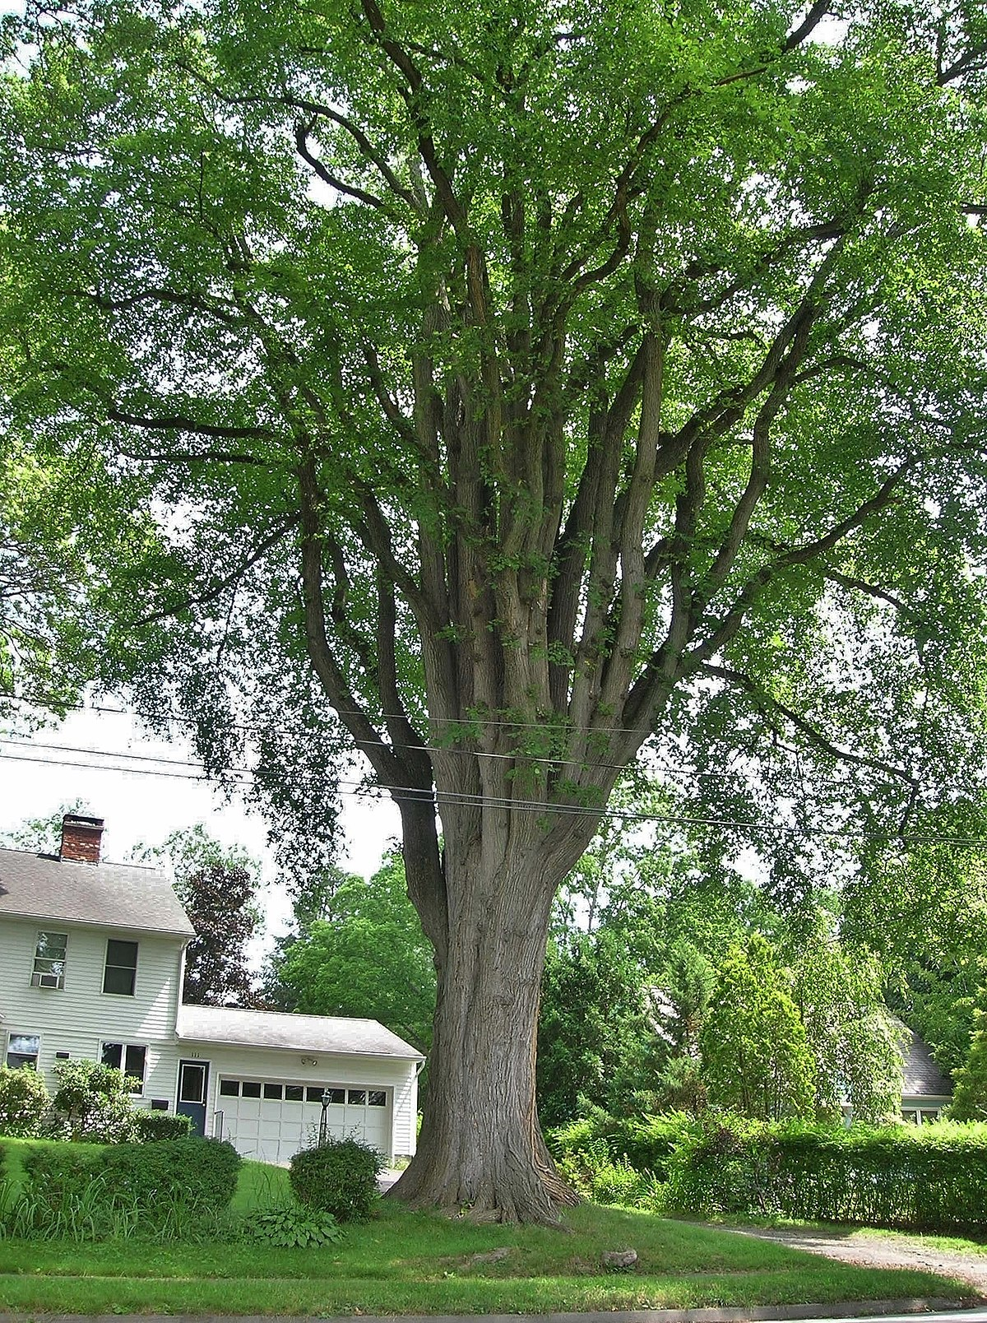




Tree 1
This Photo by Unknown Author is licensed under CC BY-SA
This Photo by Unknown Author is licensed under CC BY-SA
This Photo by Unknown Author is licensed under CC BY-SA
This Photo by Unknown Author is licensed under CC BY-SA

Slide 2

Tree
Tree Definitions
Binary Tree
Traversals
Binary Search Tree
Representations
Application : Expression Tree
AVL Tree
Which Representions ?
n-ary Tree
Generic Tree
Multiway Search Tree
B-Trees

Slide 3

Tree Definitions
A tree อาจ
empty ไม่มี nodes เรียก null tree / empty tree
หรือ
ชื่อของ tree นิยมเรืยกตาม root
ประกอบด้วย
root node
ชี้ที่ tree r
tree R
>=0 subtrees
R
edge (branch)
เชื่อม connects
root กับ subtree-root
Node ใน tree ต้อง disjoint กัน
ต้องไม่มี node ร่วมกัน ใน root หรือ ใน subtrees
A
B
C
D
E
F
G
subtree A
subtree C
H
I
J
Subtree ต้องเป็น tree ด้วย
root A
subtree : D, E
(recursive definition)
K
subtree B
K ไม่ disjoint (อยู่ในทั้ง subtree I & subtree J) → R ไม่ใช่ tree
ใน tree : branches ไม่เชื่อมเป็นวง

Slide 4
Tree Definitions
Root = father (parent) of subtree’s root.
= father ของ root ของ subtree
Root ไม่มีพ่อ
Subtree’s root (root ของ subtree)
= son (child) of his father.
= son (child) ของพ่อของมัน
r
R = father(parent)
of A B C
R
R
A
A B C = sons(childs)
of R
A
B
B
C
C
F
F
G
D
E
G
D
E
Father of F ?
Sons of A ?
Father of R ?
Sons of H ?
H
I
J
H
I
J
Leaf (leave) = Enternal node.
K
Leaf (leave) ≠ Internal node.
K
Leaf (leave)
= node with no son.
= node ที่ไม่มีลูก

Slide 5
Leaf Internal Siblings Grand Parent Grand Child
Leaf node (external, outer, terminal) node with no son
r
r
r
r
r
A
A
A
A
A
Branch node (internal, inner, inode (for short)) node ≠ leaf
B
B
B
B
C
C
C
C
D
D
D
B
C
D
D
Siblings (brothers) node with same father
E
E
E
E
F
F
F
F
G
G
G
G
H
H
H
E
F
G
H
H
Grand Parent father of father
I
I
I
I
J
J
J
I
J
J
K
K
K
K
K
Grand Child son of son
L
L
L
L
L

Slide 6
Path, Path Length, Depth, Height
Path (from n to d) sequence of nodes and edges connecting a node n with a descendant d
In tree, only 1 path from node to node
Depth (level) of node = path length from root to node
Height of node = longest path length from node to leaf
Path length = # edge in path
r
Tree Height
= Root Heigth
A
Depth = Level = 0
A
Path A,B,F
length = 2
= 4
B
Depth of C
C
Depth = Level = 1
B
C
Height of C
D
Height of D = ?
= 1
= 3
= 1
F
Depth = Level = 2
E
F
G
H
Depth = Level = 3
I
J
K
Empty Tree Height
= -1
L
Depth = Level = 4
L

Slide 7
Ancestor & Decendent
Ancestor บรรพบุรุษ father of ancestor
r
A
A = ancestor of D if has path from A to D
B
C
D
Decendent ลูกหลาน son of decendent
E
F
G
H
A = Proper Ancestor of D if A ≠ D
I
J
K
L
D = Proper Decendent of A if D ≠ A

Slide 8
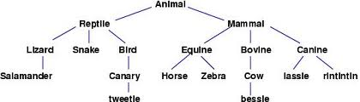
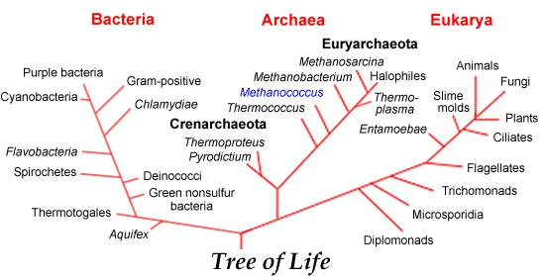
Tree Examples

Slide 9

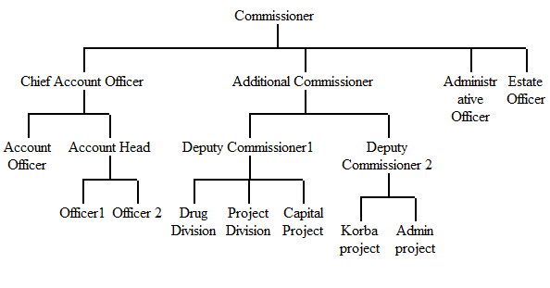
Tree Examples

Slide 10
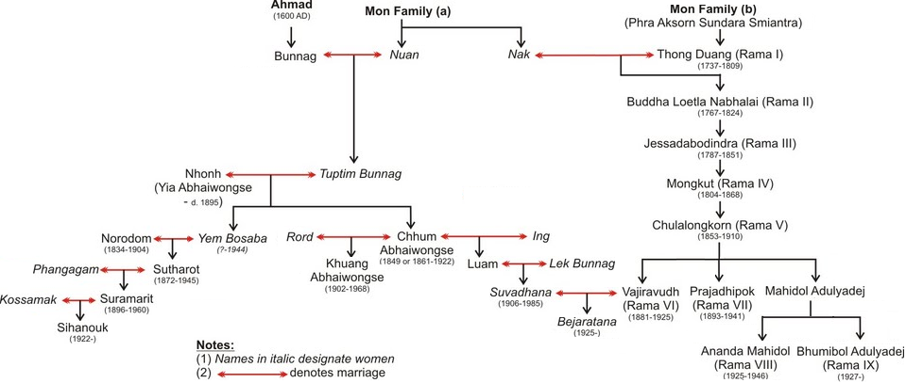
Thai Royal Family Tree

Slide 11
Tree
Tree Definitions
Binary Tree
Traversals
Binary Search Tree
Representations
Application : Expression Tree
AVL Tree
Which Representions ?
n-ary Tree
Generic Tree
Multiway Search Tree
B-Trees

Slide 12
Binary Tree
bi = 2
Binary Tree : มีอย่างมากที่สุด 2 subtrees (0, 1 or 2 subtrees)
r
1
r2
A
r3
p
2
3
B
q
4
5
6
C
r
7
8
9
D
s
10
11
Normally not draw
branch direction
null ptr

Slide 13
Perfect Binary Tree
Perfect Binary Tree (Ambiguously also called Complete Binary Tree ) Every level is completely filled
# Nodes in each level :
Depth = Level = 0
1
1=2⁰
D = L = 1
2
3
2=2¹
H Tree Height
D Leave Depth
H = D
D = L = 2
4
5
6
7
4=2²
D = L = 3
8
9
10
11
12
13
14
15
8=2³
D = L = 4
16
17
18
19
20
21
22
23
24
25
26
27
28
29
30
31
16=2⁴=2^{D}
N = จำนวน node ใน perfect binary tree
N = 2⁰+2¹+...+2^{H}
N = 2^{H+1} - 1
H = D = log₂ (N+1) –1
O( log₂(N))
N = (2^{H}external) + (2^{H}-1 internal)
Perfect Binary Tree of N nodes height H :
H = log₂ (N+1) –1
N = 2^{H+1} - 1

Slide 14
Complete BinaryTree
Complete Binary Tree Every level, except possibly the last, is completely filled & All nodes are as far left as possible.
1
1
2
3
2
3
4
5
6
7
4
5
6
7
8
9
10
11
12
8
9
10
11
12
Complete binary tree
Without node 11 :
Not a complete binary tree

Slide 15
Perfect Binary Tree & Complete Binary Tree
N จำนวน node และ H ความสูง
Perfect Binary Tree
H = log₂ (N+1) –1
= ⌊ log₂N ⌋ → O( log₂(N))
N = 2^{H+1} - 1
Complete Binary Tree
H = log₂ (N+1) –1
= ⌊ log₂N ⌋ → O( log₂(N))
=
N ระหว่าง [2^{H}, ]
2^{H+1} – 1
# Nodes in each level
D = L = 0
1
1=2⁰
1
D = L = 1
2
3
2=2¹
2
3
D = L = 2
4
5
6
7
4=2²
4
5
6
7
D = L = 3
8
9
10
11
12
13
14
15
8=2³
2^{H} =2³ = 8
8
9
10
15
2^{H+1} -1
= 2⁴
= 15
D = L = 4
16
17
18
19
20
21
22
23
24
25
26
27
28
29
30
31
16=2⁴=2^{D}
16
2^{H+1} =2⁴ = 16
H Tree Height
D Leave Depth
H = D
N total # of nodes
= 2⁰+2¹+...+2^{H}
= 2^{H+1} – 1
เป็น external 2^{H}
internal 2^{H}-1
Perfect Binary Tree
Every level is completely filled
(Ambiguously also called Complete Binary Tree )
Complete Binary Tree
Every level is completely filled, except possibly the last, & All nodes are as far left as possible

Slide 16
Complete Binary Tree : H and N
How can 10 nodes in a binary tree has
longest search path ?
shortest search path ?
1
1
2
2
3
3
4
5
6
7
4
8
9
10
5
6
Worst Case Height
Like Linked list : H = N – 1
O(N)
Best Case Height
Complete Binary Tree of N nodes height H :
H = D = ⌈ log₂ (N+1) –1 ⌉ = ⌊ log₂N ⌋
O(log N)
7
8
9
10
How much different N vs log₂N ?
Log ₂ 1,000,000 < 20
So
Complete Binary Tree is an ideal tree

Slide 17
Full (proper, strictly, 2-tree) BinaryTree
Full Node = node with 2 children
r
A
A
Full binary tree node = full node or leaf
edge top
edge top
B
B
C
edge bottom
C
# external = # internal + 1
D
E
F
G
D
E
F
G
Proof :
edge top = 2 #internal
H
I
J
K
H
I
J
K
edge bottom = #external + #internal – 1 (root)
edge bottom = edge top
∴ #external + #internal – 1 = 2 #internal
#external = #internal +1
L
M
N
P
L
M
N
P
Q
R
How good ?
Q
R
Try add every leaf with 2 sons.
See how good?
Before : N = 17
Add = 18 more
Max Search Path = Tree’s Height
Max Search Path
increases only 1

Slide 18
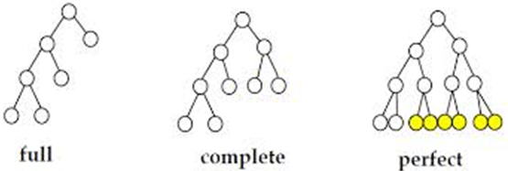
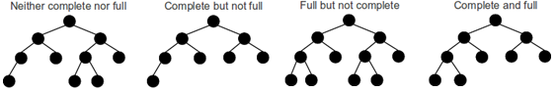
Full Complete Perfect

Slide 19
Binary Search Tree
Binary Search Tree : for every node A
left decendents < A
right decendents ≥ A
r
14
r2
A
r3
8
<
≥
≥
<
4
15
B
5
<
≥
≥
≥
≥
3
9
18
C
6
<
<
≥
≥
≥
7
16
20
D
7
<
≥
5
16

Slide 20
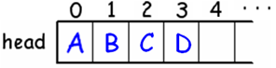


Why Tree ?
Implicit (Sequential ) Array
Insertion – Deletion Problems
Linear Linked list
Linear Search
O(n)
UNIX
File system of several popular OS
Tree
Tree Search
O(log₂n)

Slide 21
Tree
Tree Definitions
Binary Tree
Traversals
Binary Search Tree
Representations
Application : Expression Tree
AVL Tree
Which Representions ?
n-ary Tree
Generic Tree
Multiway Search Tree
B-Trees

Slide 22
Binary Tree Traversals
Tree Traversal
การไปเยี่ยม (visit เช่นการพิมพ์ การ update ข้อมูล) ทุก node node ละ 1 ครั้ง อย่างมีระบบ
แบ่งตามลำดับของการ visit
Breadth First (Level Order) จาก root ไปด้านข้างก่อน
ลูกคนแรก ลูกคนที่ 2 ลูกคนที่ 3 ...จนหมดลูกทุกคน
ทำข้อ 1. กับทุกคนทีไปเยี่ยมมาตามลำดับ
Depth-First Order จาก root ไปด้านลึกก่อนไปด้านข้าง
ลูกคนแรก แล้วไปหลานคนแรกก่อนไปที่ลูกคนที่ 2

Slide 23
Breadth - First (Level Order)
Breadth First จาก root ไปด้านข้างก่อน ใช้ queue ช่วยในการหา
ลูกคนแรก ลูกคนที่ 2 ลูกคนที่ 3 ...จนหมดลูกทุกคน
ทำข้อ 1. กับทุกคนทีไปเยี่ยมมาตามลำดับ
A B C D E F G H I
ไล่ไปทีละ level จึงเรียกอีกอย่างหนึ่งว่า Level Order
A
enQ ( root )
while ( notEmptyQ ) {
n = deQ ( )
visit(n)
if ( n->left ) enQ ( n->left )
if ( n->right ) enQ ( n-> right )
}
B
C
D
E
F
G
H
I
queue
A
B
C
D
E
F
G
H
I
deQ & visit

Slide 24
Depth – First Order
Depth-First Order จาก root ไปด้านลึกก่อนไปด้านข้าง ใช้ stack ช่วยในการหา
ไปลูกคนแรก แล้วไปหลานคนแรกก่อนไปที่ลูกคนที่ 2
แบ่งเป็น 3 แบบ ขึ้นกับการวางตำแหน่งการ visit root ไว้ที่ใด
Inorder (Symmetric Order)
Preorder
Postorder
inOrder(leftSubtree)
visit_root
inOrder(rightSubtree)
visit_root
preOrder(leftSubtree)
preOrder(rightSubtree)
postOrder(leftSubtree)
postOrder(rightSubtree)
visit_root

Slide 25
Inorder (Symmetric Order)
Algorithm:
inOrder( root ) {
if (root != null){
inOrder(left subtree)
visit(root)
inOrder(right subtree)
}
}
pre
ข
post
ก
ค
in
2
A
1
2
B
3
2
C
1
2
D
3
1
2
E
3
2
F
1
3
G
1
3
H
1
I
3
1
2
3
1
2
3
1
2
3
D
G
B
A
E
H
C
I
F
1
2
3

Slide 26
Preorder
Algorithm:
preOrder( root ) {
if (root != null){
visit(root)
preOrder(left subtree)
preOrder(right subtree)
}
}
pre
ข
post
ก
ค
in
A
B
C
D
E
F
G
H
I
A B D G C E H F I

Slide 27
Postorder
Algorithm:
postOrder( root ) {
if (root != null){
postOrder(left subtree)
postOrder(right subtree)
visit(root)
}
}
pre
ข
post
ก
ค
in
A
B
C
D
E
F
G
H
I
G D B H E I F C A

Slide 28
Test Your Self
pre
ข
post
Binary Search Tree
Inorder : LrootR
inOrder(L)
visit_root
inOrder(R)
ก
ค
r
14
in
A
B
4
15
Postorder : LRroot
C
D
3
9
18
Preorder : rootLR
E
F
G
H
7
16
20
I
J
K
L
5
16
Inorder
E I C F J B G D K H L A
3 4 5 7 9 14 15 16 16 18 20
Asscending Order !
Preorder
A B C E I F J D G H K L
14 4 3 9 7 5 15 18 16 16 20
Postorder
I E J F C G K L H D B A
3 5 7 9 4 16 16 20 18 15 14

Slide 29
Tree
Tree Definitions
Binary Tree
Traversals
Binary Search Tree
Representations
Application : Expression Tree
AVL Tree
Which Representions ?
n-ary Tree
Generic Tree
Multiway Search Tree
B-Trees

Slide 30
Binary SearchTree
Binary Search Tree : for every node A
left decendents < A
right decendents ≥ A
r
14
r2
A
r3
8
<
≥
≥
<
4
15
B
5
<
≥
≥
≥
≥
3
9
18
C
6
<
<
≥
≥
≥
7
16
20
D
7
<
≥
5
16

Slide 31
Insertion
r
14
<
≥
4
15
<
≥
≥
3
9
18
<
<
≥
7
16
20
<
≥
5
16
Inserts : 14 4 9 7 15 3 18 16 20 5 16

Slide 32
Delete a : Leaf, Node with only 1 child
r
14
r
14
4
15
4
15
3
9
18
3
7
18
7
16
20
5
16
5
16
16
Delete Leaf
20 can be deleted right away, still be a binary search tree
Delete a node with only one child
Delete 9, replace a subtree at the deleted node

Slide 33
Delete a Node with Both Children : Lazy Deletion 1
r
3
r
3
2
12
2
17
1
7
17
1
13
19
5
11
13
19
7
15
18
20
4
6
9
15
18
20
5
11
14
16
8
10
14
16
4
6
9
Increases tree height.
=> Lazy Deletion
8
10
Delete 12
Where can we put tree 7, and tree 17 ?
Can replace only 1 at the deleted node.
Let choose 17.
Where to put tree 7 ?
It’s a binary search tree!
Where is it’s place ?

Slide 34
Delete a Node with Both Children : Lazy Deletion 2
r
3
r
3
2
12
2
7
1
7
17
1
5
11
5
11
13
19
4
6
9
17
4
6
9
15
18
20
8
10
13
19
8
10
14
16
Increases tree height.
=> Lazy Deletion
15
18
20
14
16
Delete 12
Can replace only 1 at the deleted node.
If we choose 7.
Where is 17’s place ?

Slide 35
Deletion : Using Inorder Successor / Predecessor
r
3
r
3
13 = inorder successor of 12
2
12
Replace 12 with data 13
2
12 13
Delete 13 instead
as 1 child deletion
1
7
17
1
7
17
5
11
13
19
5
11
13
19
4
6
9
20
Not increasing
tree height !!!
4
6
9
20
15
18
15
18
8
10
14
16
8
10
14
16
r
3
11 = inorder predecessor of 12
r
3
2
12
Replace 12 with data 11
2
12 11
Delete 11 instead
as 1 child deletion
1
7
17
1
7
17
5
11
13
19
5
11
13
19
4
6
9
15
18
20
4
6
9
15
18
20
8
10
14
16
8
10
14
16

Slide 36
Tree
Tree Definitions
Binary Tree
Traversals
Binary Search Tree
Representations
Application : Expression Tree
AVL Tree
Which Representions ?
n-ary Tree
Generic Tree
Multiway Search Tree
B-Trees

Slide 37
Binary Tree Representations
Dynamic
class node:
def __init__(self, data, left = None, right = None):
self.data = data
self.left = None if left is None else left
self.right = None if right is None else right
r
6
3
9
1
5
Sequential (Implicit) Array
A
A
B
0
C
B
1
C
1
2
D
2
F
3
G
D
F
G
3
4
5
6
4
5
6
7
I
L
M
I
L
M
7
8
9
10
11
12
13
14
8
9
10
11
12
13
14
15
A | B | C | D |  | F | G |  | I |  |  | L | M
0 | 1 | 2 | 3 | 4 | 5 | 6 | 7 | 8 | 9 | 10 | 11 | 12 | 13 | 14
 | A | B | C | D |  | F | G |  | I |  |  | L | M
0 | 1 | 2 | 3 | 4 | 5 | 6 | 7 | 8 | 9 | 10 | 11 | 12 | 13 | 14 | 15

Slide 38
(Sequential) Implicit Array
A
A
B
0
C
B
1
C
D
1
E
F
2
G
D
2
E
F
3
G
3
4
5
6
4
5
6
7
H
I
J
K
L
M
N
O
H
I
J
K
L
M
N
O
7
8
9
10
11
12
13
14
8
9
10
11
12
13
14
15
A | B | C | D | E | F | G | H | I | J | K | L | M | N | O
0 | 1 | 2 | 3 | 4 | 5 | 6 | 7 | 8 | 9 | 10 | 11 | 12 | 13 | 14
 | A | B | C | D | E | F | G | H | I | J | K | L | M | N | O
0 | 1 | 2 | 3 | 4 | 5 | 6 | 7 | 8 | 9 | 10 | 11 | 12 | 13 | 14 | 15
A
A
B
0
C
B
1
C
D
1
F
2
G
D
2
F
3
G
3
4
5
6
4
5
6
7
I
L
M
I
L
M
7
8
9
10
11
12
13
14
8
9
10
11
12
13
14
15
A | B | C | D |  | F | G |  | I |  |  | L | M
0 | 1 | 2 | 3 | 4 | 5 | 6 | 7 | 8 | 9 | 10 | 11 | 12 | 13 | 14
 | A | B | C | D |  | F | G |  | I |  |  | L | M
0 | 1 | 2 | 3 | 4 | 5 | 6 | 7 | 8 | 9 | 10 | 11 | 12 | 13 | 14 | 15

Slide 39
(Sequential) Implicit Array
A
A
B
0
C
B
1
C
D
1
F
2
G
D
2
F
3
G
3
4
5
6
4
5
6
7
I
L
M
I
L
M
7
8
9
10
11
12
13
14
8
9
10
11
12
13
14
15
A | B | C | D |  | F | G |  | I |  |  | L | M
0 | 1 | 2 | 3 | 4 | 5 | 6 | 7 | 8 | 9 | 10 | 11 | 12 | 13 | 14
 | A | B | C | D |  | F | G |  | I |  |  | L | M
0 | 1 | 2 | 3 | 4 | 5 | 6 | 7 | 8 | 9 | 10 | 11 | 12 | 13 | 14 | 15
Start at index 0
Start at index 1
Where is the root ?
0
1
The node at index i ‘s
left son ?
2 i + 1
2 i
right son ?
2 i + 2
2 i + 1
father ?
(i - 1) div 2
i div 2
So good ! No memory for link ! Easy to calculate !
What happen if we have only node at indices : 0, 2, 6, 14 ? ie. sparse
What shape of tree should be best for sequential array?

Slide 40
Tree
Tree Definitions
Binary Tree
Traversals
Binary Search Tree
Representations
Application : Expression Tree
AVL Tree
Which Representions ?
n-ary Tree
Generic Tree
Multiway Search Tree
B-Trees

Slide 41
Example : Expression Tree
r
+
+
*
a
*
+
g
b
c
*
f
d
e
(a + b * c) + ((d * e + f) * g)

Slide 42
Constructing an Expression Tree
stack S
input postfix form
a
b
a b + c d e + * *
+
c
d
e
a
b
+
c
+
Scan input from left to right.
a
b
d
e
Operand
Create an operand node and push to the stack
+
*
a
b
c
+
Operator
d
e
Create an operator node
*
+
*
Pop 2 operands to be its children.
a
b
c
+
Push to the stack.
d
e

Slide 43
Node
class node:
def __init__(self, data, left = None, right = None):
self.data = data
self.left = None if left is None else left
self.right = None if right is None else right
def __str__(self):
return str(self.data)
def getData(self): # accessor
return self.data
def getLeft(self): # accessor
return self.left
def getRight(self): # accessor
return self.right
def setData(self, data): # mutator
self.data = data
def setLeft(self, left): # mutator
self.left = left
def setRight(self, right): # mutator
self.right = right

Slide 44
Dynamic Representation 1
class BST:
def __init__(self, root = None):
self.root = None if root is None else root
def addI(self, data):
if self.root is None:
self.root = node(data)
else:
# YOUR CODE
def add(self, data):
self.root = BST._add(self.root, data)
def _add(root, data):
if root is None:
return node(data)
else:
if data < root.data:
root.left = BST._add(root.left, data)
else:
root.right = BST._add(root.right, data)
return root
r
6
3
9
1
5
if data < root.getData():
root.setLeft(BST._add(root.getLeft(), data))
else:
root.setRight(BST._add(root.getRight(), data))

